Slide 1
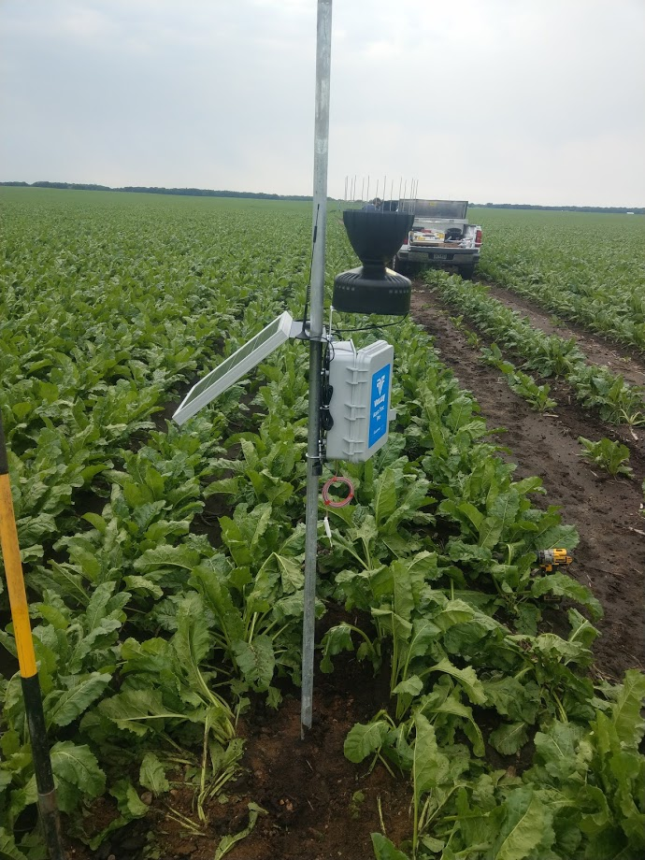
Anderson Farms - Irrigation
Soil moisture probes
Telemetry / rain gauges
Checkbook method
Drop nozzles / low pressure
MN AG water Quality Certified 2018

Slide 2
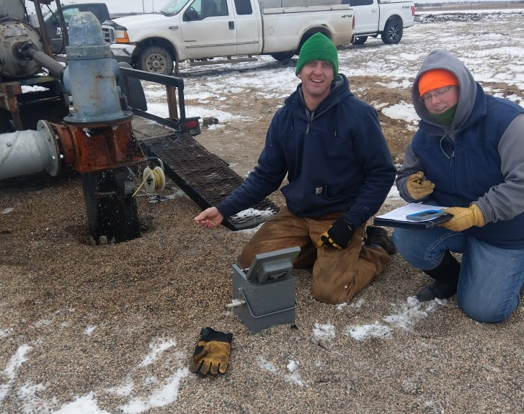
Anderson Farms –
Irrigation
90 + Irrigation Wells
Permitted and reported MN DNR
Tested for nitrate
Backflow preventers

Slide 3
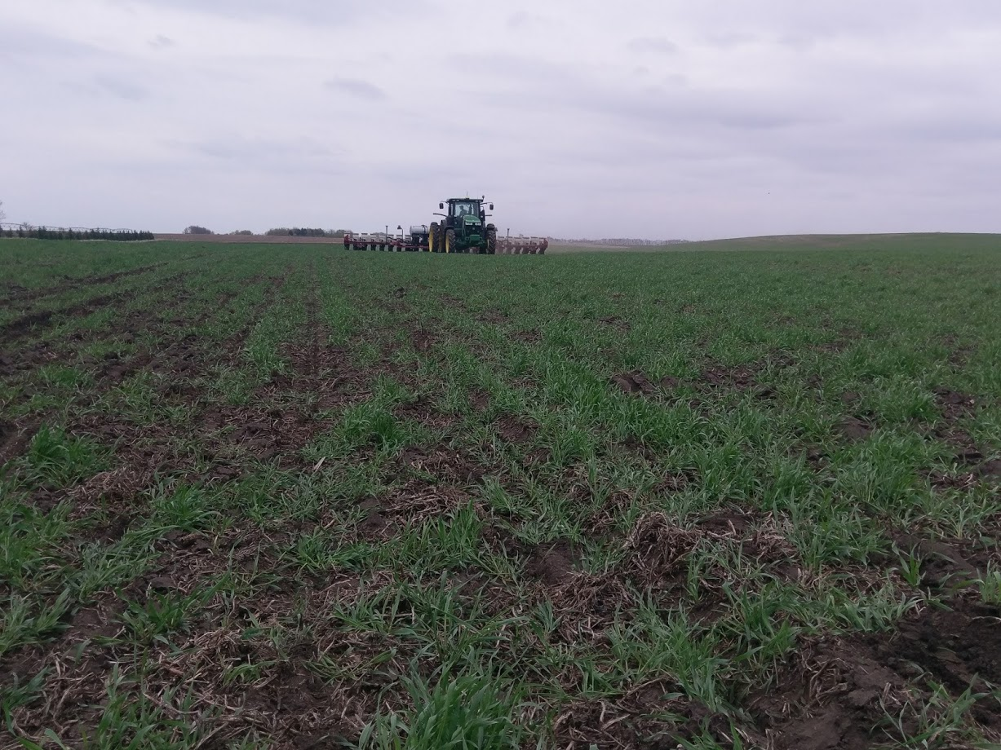

Slide 4
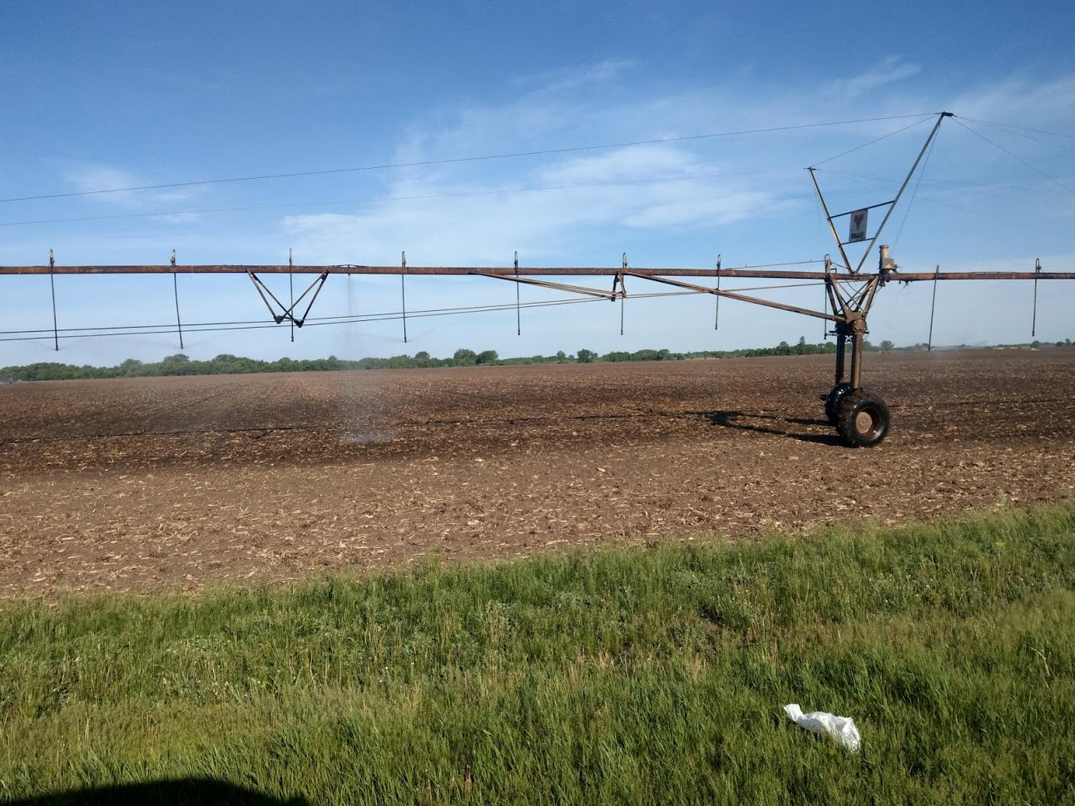

Slide 5
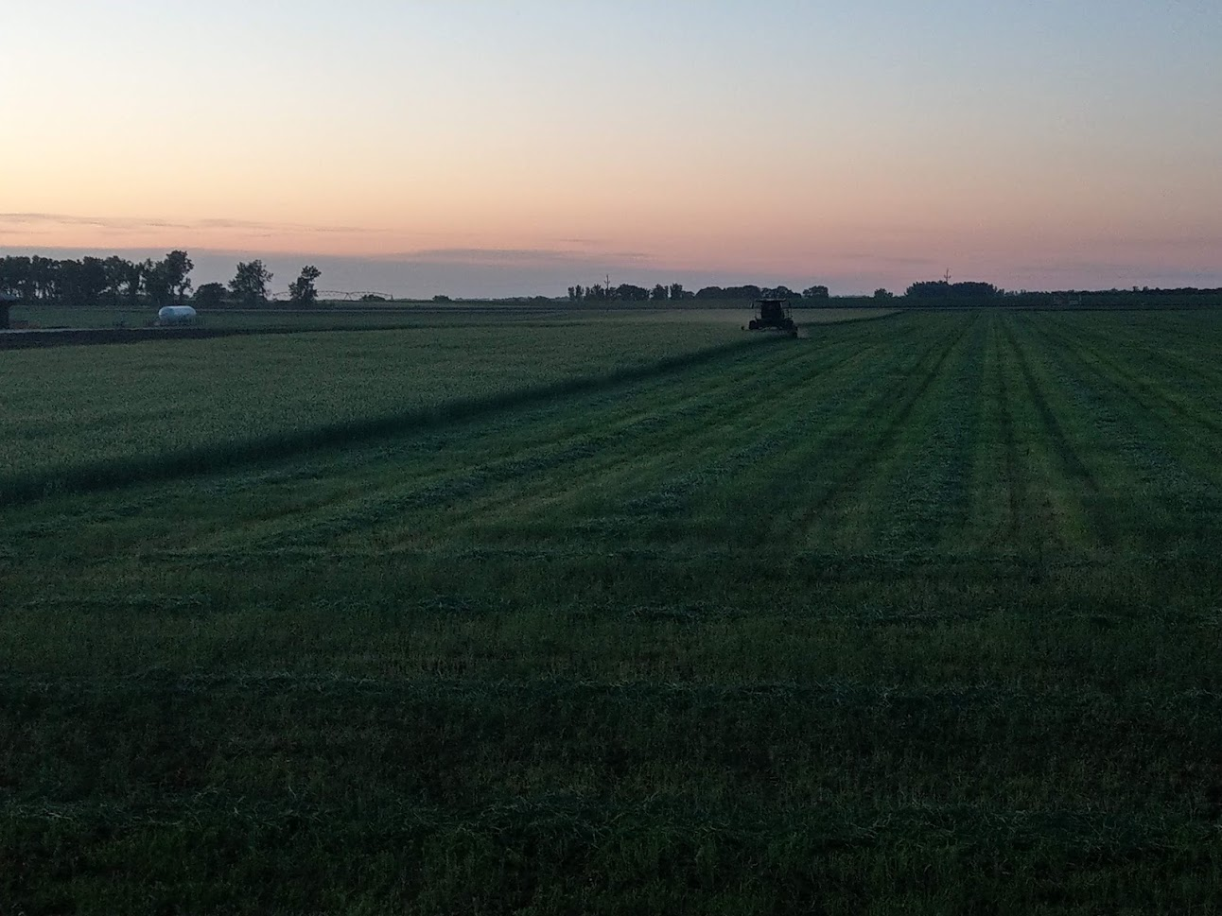

Slide 6
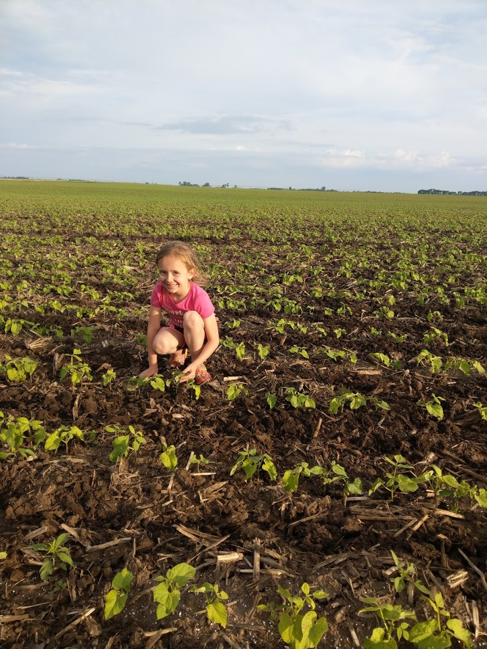

Slide 7
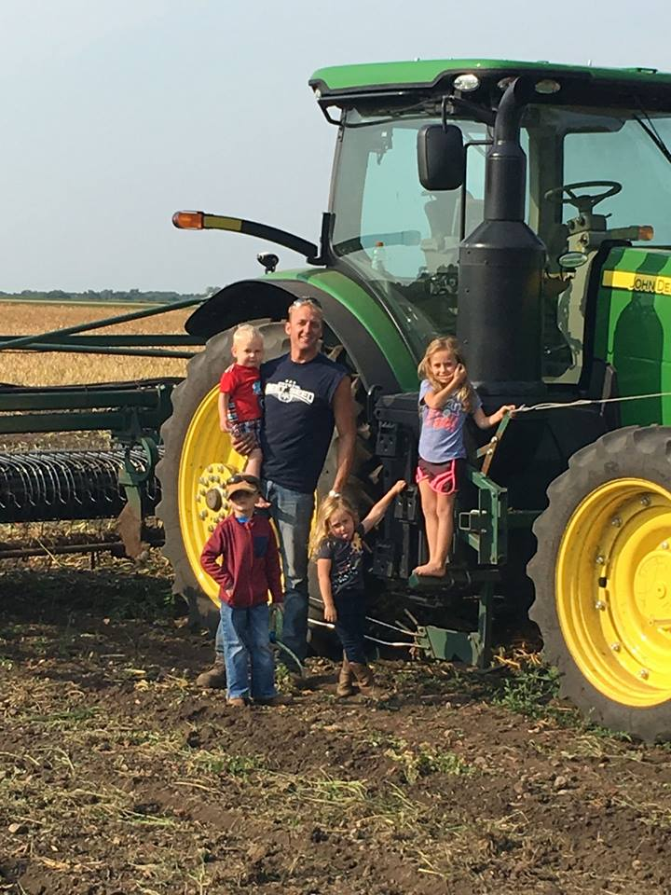
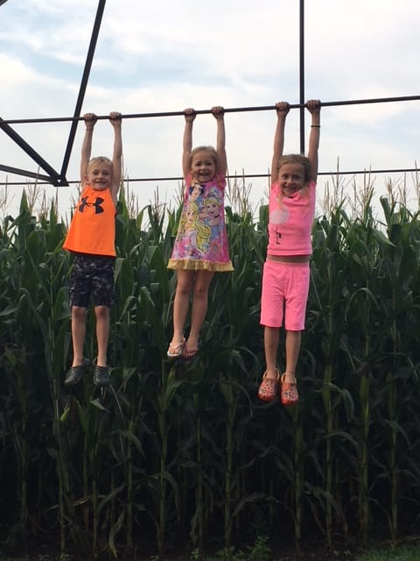

Slide 8
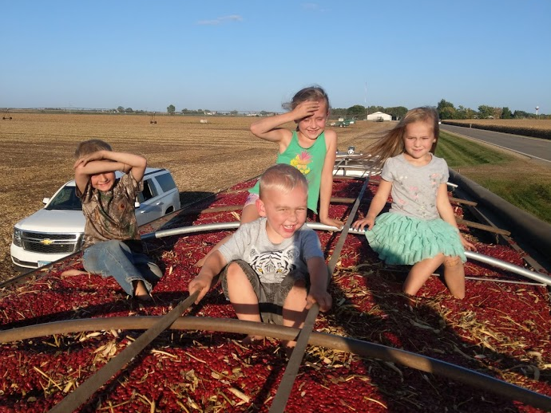
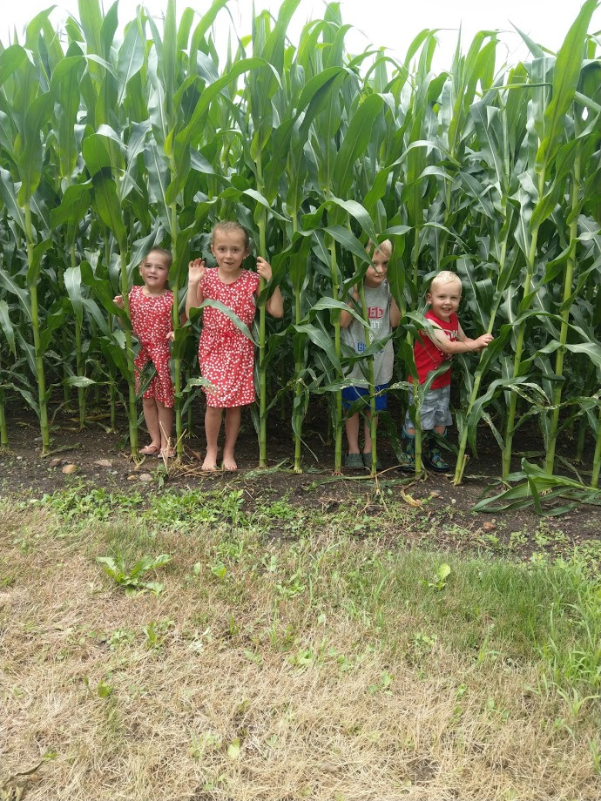
https://www.youtube.com/watch?v=JHyZ1SHzK5s

